Slide 1
CS1231 Tutorial 2
AY18/19 – WEEK 4
Andrew Tan

Slide 2
Tutorial resources
All tutorial resources will be emailed after each tutorial.
Github repository:
https://github.com/andrewtanJS/CS1231-AY18-19

Slide 3
Predicates and quantified statements
Predicate - sentence that contains a finite number of values and becomes a statement when specific values are substituted for the variables.
Domain - set of all values that may be substituted in place of the variable.
Truth set – set of all elements that make a predicate P(x) true when substituted for x

Slide 4

Universal quantifier
Denoted with $"∀“$
Universal statement has the form: $∀x∈D, Q(x)$

Slide 5

Existential quantifier
Denoted with “$∃“$
Existential statement has the form: $∃x∈D \text{such} \text{that} Q( x)$

Slide 6
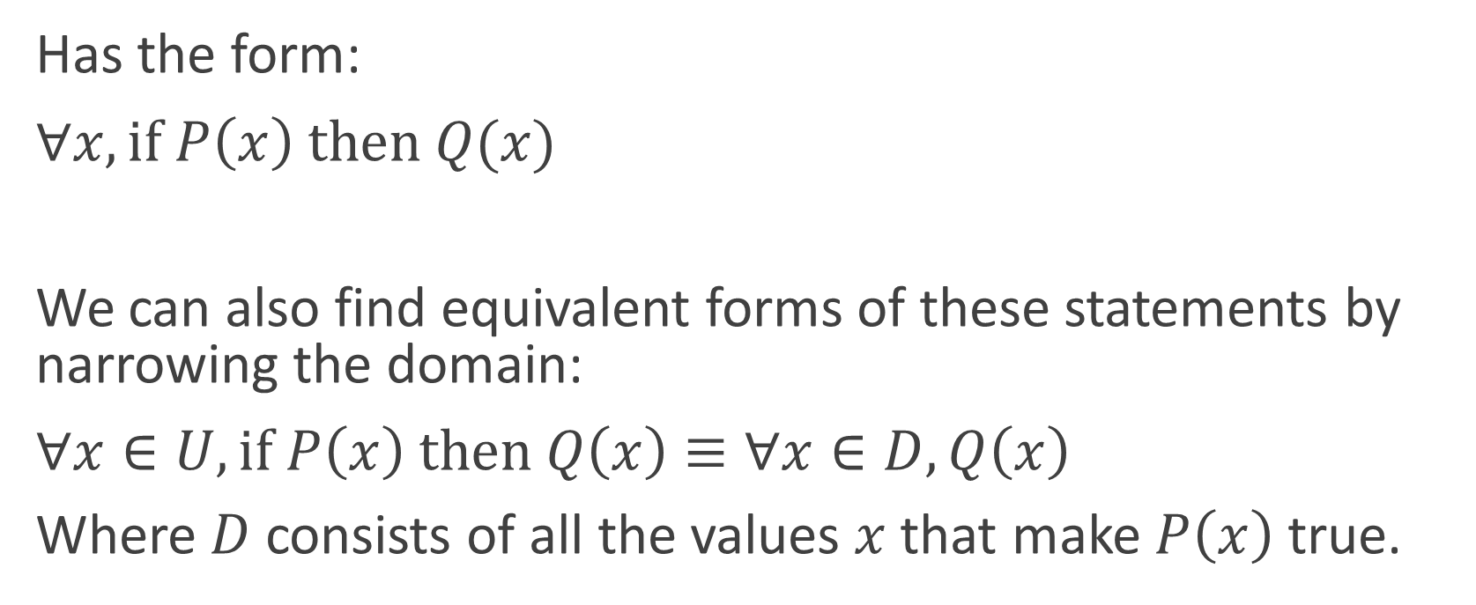
Univeral conditional statement
Has the form:
$∀x, if P\left(x\right) then Q(x)$
We can also find equivalent forms of these statements by narrowing the domain:
$∀x∈U, if P\left(x\right) then Q\left(x\right)≡∀x∈D, Q\left(x\right)$
Where $D$consists of all the values $x$that make $P\left(x\right)$ true.

Slide 7

Implicit quantification
$P\left(x\right) ⇒Q(x)$ is equivalent to $∀x, P\left(x\right)→Q\left(x\right)$
$P\left(x\right) ⇔Q(x)$ is equivalent to $∀x, P\left(x\right)↔Q\left(x\right)$

Slide 8
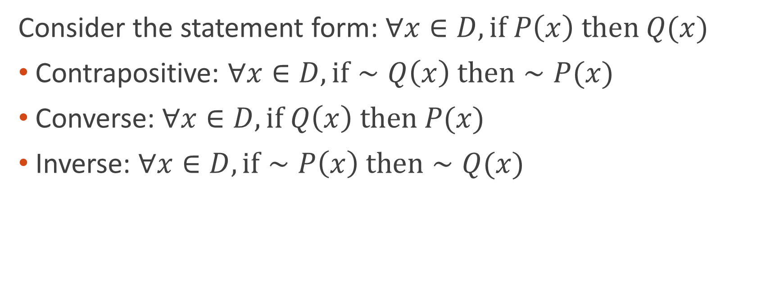
Variants of universal conditional statements
Consider the statement form: $∀x∈D, if P\left(x\right) then Q(x)$
Contrapositive: $∀x∈D, if∼Q\left(x\right) then∼P(x)$
Converse:$∀x∈D, if Q\left(x\right) then P(x)$
Inverse: $∀x∈D, if∼P\left(x\right) then∼Q(x)$

Slide 9
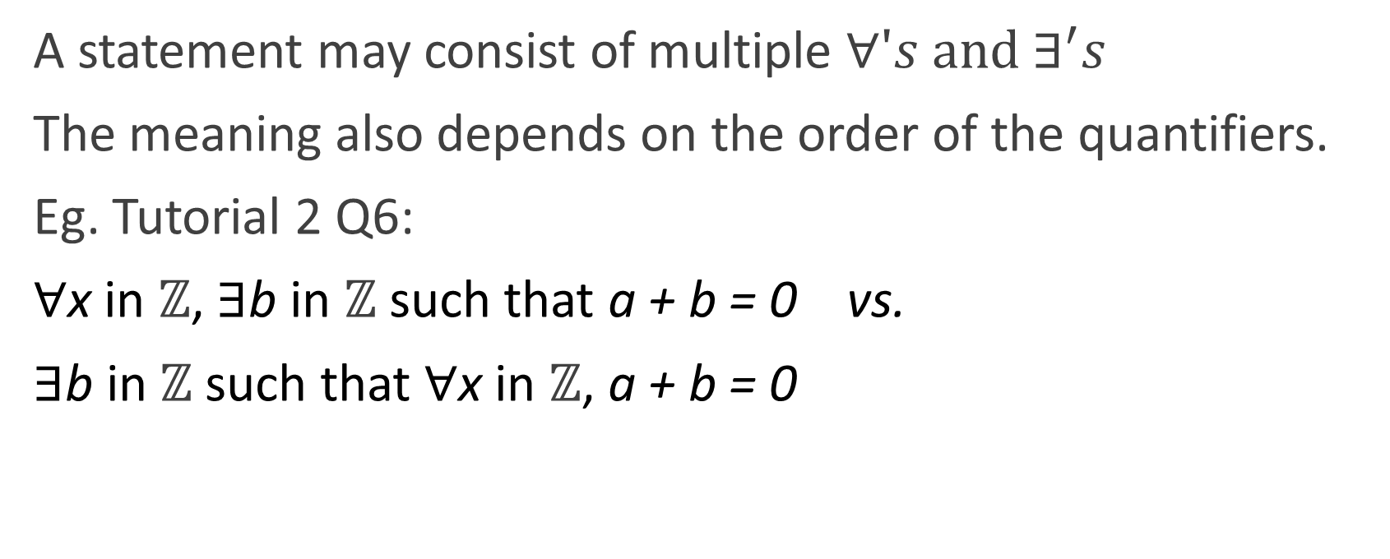
Statements with multiple quantifiers
A statement may consist of multiple $∀'s and ∃^{′}s$
The meaning also depends on the order of the quantifiers.
Eg. Tutorial 2 Q6:
∀x in ℤ, ∃b in ℤ such that a + b = 0 vs.
∃b in ℤ such that ∀x in ℤ, a + b = 0

Slide 10
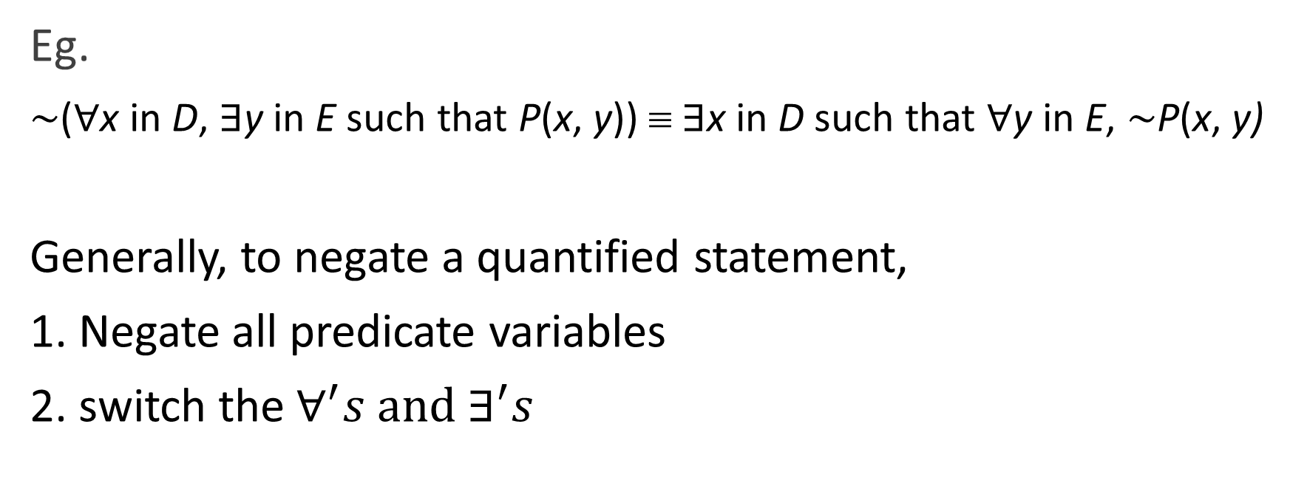
Negation of quantified statements
Eg.
∼(∀x in D, ∃y in E such that P(x, y)) ≡ ∃x in D such that ∀y in E, ∼P(x, y)
Generally, to negate a quantified statement,
1. Negate all predicate variables
2. switch the $∀^{′}s and ∃^{′}s$

Slide 11
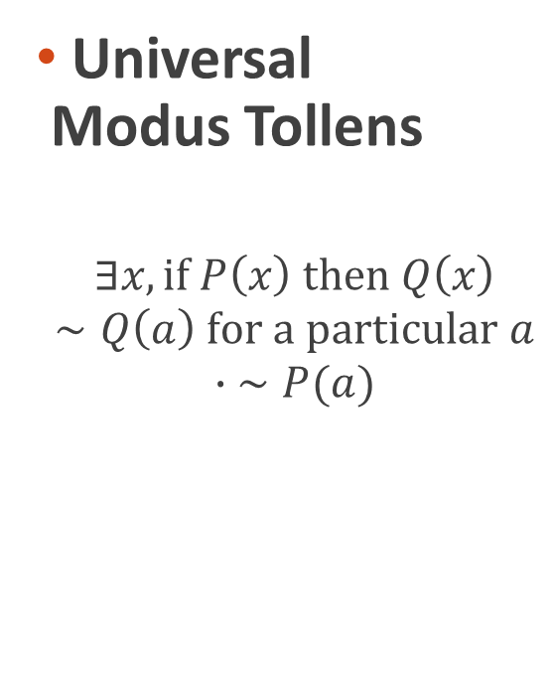
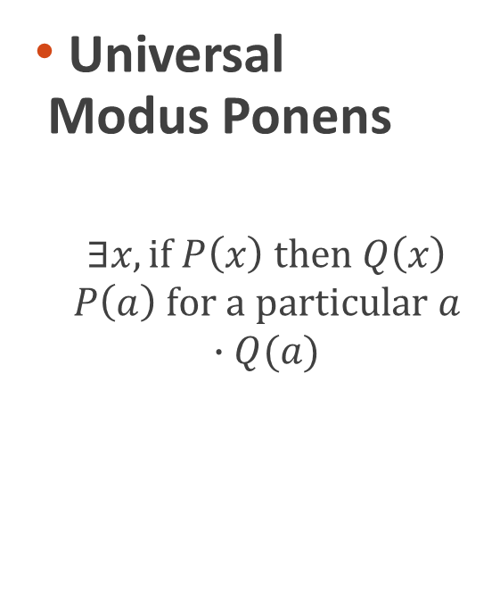
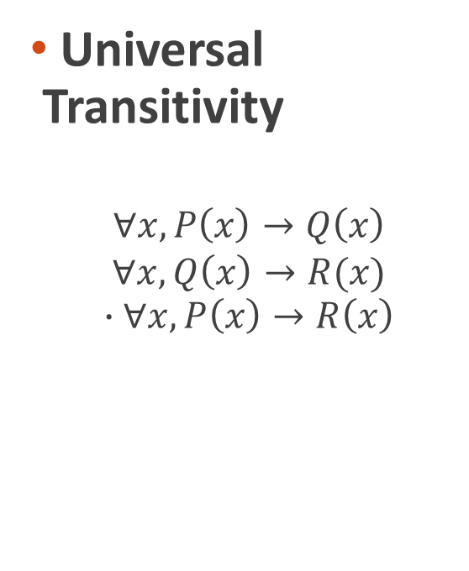
Arguments with quantified statements
Universal Modus Ponens
$$∃x, if P\left(x\right) then Q\left(x\right)$$
$$P\left(a\right) for a particular a$$
$$∙Q(a)$$
Universal Modus Tollens
$$∃x, if P\left(x\right) then Q\left(x\right)$$
$$∼Q\left(a\right) for a particular a$$
$$∙ ∼P(a)$$
Universal Transitivity
$$∀x, P\left(x\right)→Q\left(x\right)$$
$$∀x, Q\left(x\right)→R(x)$$
$$∙∀x, P\left(x\right)→R\left(x\right)$$

